Slide 1



DATA SCINCE PROJECT
15 DECEMBER, 2025
DR.ABDULLAH ALMISMAR
YOUSEF MOATEQ ALRASHIDI
HASSAN ABDULHADI ALHUSSEIN
AHMED BANDER ALSHAMMARI

Slide 2
ANALYZING STUDENT PERFORMANCE USING DATA SCIENCE
CASE STUDY :
TEST PREPARATION COURSE & GENDER
DATASET :
STUDENTSPERFORMANCE.CSV
RESEARCH QUESTION :
IS THE PERFORMANCE LEVEL OF FEMALE STUDENTS WHO COMPLETED
THE TEST PREPARATION COURSE BETTER THAN THAT OF MALE STUDENTS WHO COMPLETED THE SAME COURSE?
HYPOTHESIS :
FEMALE STUDENTS WHO COMPLETED THE PREPARATION
COURSE ACHIEVE HIGHER OVERALL SCORES THAN MALES.

Slide 3
DATASET OVERVIEW
SOURCE: STUDENT PERFORMANCE DATASET
FEATURES INCLUDE:
[GENDER] [MATH] [SCORE] [READING] [SCORE] [WRITING SCORE]
[TEST PREPARATION COURSE STATUS]
DATASET IS CLEAN:
NO MISSING VALUES
NO NEED FOR DATA IMPUTATION

Slide 4
DATA INSPECTION
STEPS PERFORMED:
LOADED THE DATASET USING THE PANDAS LIBRARY
Checked the data types of columns and the number of values
VERIFIED THAT THERE ARE NO MISSING (NULL) VALUES
RESULT:
THE DATASET IS CLEAN AND READY FOR DIRECT ANALYSIS.

Slide 5
CREATING OVERALL SCORE
AFTER INSPECTING THE DATA, WE CREATED A NEW FEATURE CALLED OVERALL SCORE.
IT REPRESENTS THE STUDENT’S OVERALL ACADEMIC PERFORMANCE
CALCULATED AS THE AVERAGE OF:
MATH SCORE
READING SCORE
WRITING SCORE
FORMULA:
OVERALL SCORE = (MATH + READING + WRITING) / 3
PURPOSE:
TO SIMPLIFY COMPARISON AND ANALYZE PERFORMANCE USING A SINGLE METRIC.

Slide 6
DATA FILTERING
AFTER CREATING THE OVERALL SCORE, I FILTERED THE DATASET TO FOCUS ON THE TARGET GROUP.
SELECTED ONLY STUDENTS WHO COMPLETED THE TEST PREPARATION COURSE
DIVIDED THE DATA BASED ON GENDER (MALE AND FEMALE)
THIS ENSURES A FAIR COMPARISON UNDER THE SAME CONDITIONS
PURPOSE:
TO COMPARE STUDENT PERFORMANCE ACCURATELY.

Slide 7
DESCRIPTIVE STATISTICS MALE & FEMALE STUDENTS
FEMALE
MALE
HIGHER AVERAGE SCORES IN:
SLIGHTLY HIGHER VARIABILITY IN:
READING
WRITING
MATH SCORES
OVERALL SCORE
LOWER VARIABILITY COMPARED TO MALES
LOWER OVERALL AVERAGE COMPARED TO FEMALES
MORE CONSISTENT ACADEMIC PERFORMANCE
WIDER SCORE DISPERSION

Slide 8
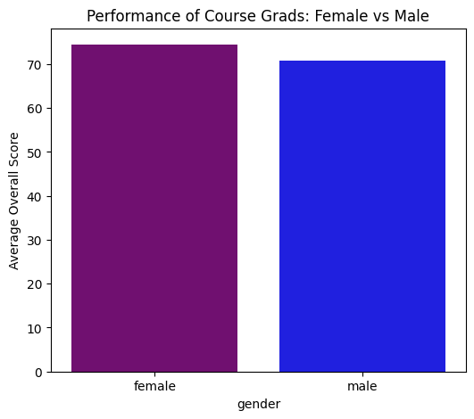
VISUALIZATION AVERAGE OVERALL SCORE
THIS BAR CHART SHOWS THE COMPARISON OF THE AVERAGE OVERALL SCORE BETWEEN MALE AND FEMALE STUDENTS WHO COMPLETED THE TEST PREPARATION COURSE.

Slide 9
STATISTICAL ANALYSIS SKEWNESS
SKEWNESS OF OVERALL SCORE DISTRIBUTION
CALCULATED SKEWNESS FOR MALE STUDENTS
PURPOSE:
UNDERSTAND DISTRIBUTION SHAPE DETECT PERFORMANCE CONCENTRATION
RESULT:
DISTRIBUTION SLIGHTLY SKEWED
INDICATES UNEQUAL PERFORMANCE SPREAD

Slide 10
CORRELATION ANALYSIS
PEARSON & SPEARMAN CORRELATION
USED PEARSON & SPEARMAN METHODS
COMPARED OVERALL SCORE WITH ITSELF (CONTROL TEST)
RESULT:
CORRELATION = 1.0
CONFIRMS CORRECTNESS OF STATISTICAL METHOD

Slide 11
FINAL CONCLUSION
HYPOTHESIS ACCEPTED
FEMALE STUDENTS WHO COMPLETED THE TEST PREPARATION COURSE:
ACHIEVED HIGHER OVERALL SCORES
SHOWED MORE CONSISTENT PERFORMANCE
THE PREPARATION COURSE IS MORE EFFECTIVE FOR FEMALES
TOOLS & TECHNOLOGIES
PYTHON
PANDAS
NUMPY
MATPLOTLIB
GOOGLE COLAB

Slide 12
THANK YOU

